Slide 1
Predicting IBM stock price based on external factors
Presented by: Andy (Chi-En) , Gelareh, Ritu, Shuang

Slide 2
Motivation
Capital markets play a critical role in a country's economy. Stock is one of the capital market investment vehicles that many investors are interested in.
Stock prices fluctuate over time in response to market activity, which is determined by the strength of demand and supply for that particular shares in the market.
For our project, we wanted to explore external factors that can be used to predict the stock price of a company, in order to maximize gains for investors.

Slide 3

Why IBM?
Established, Stable and Well recognized organization
High Volume trading
Extensive and readily available information

Slide 4
External factors
NASDAQ index
S&P 500 index
Daily break even inflation rates
GDP
Yield rates of Bonds

Slide 5
Data Preprocessing
[Collection phase]
IBM stock prices - Yahoo Finance
NASDAQ index - Yahoo Finance
S&P index - Yahoo Finance
Inflation rate - FRED economic data
GDP - BEA
Yield rate - US Department of treasure

Slide 6
Data preprocessing
[Cleaning phase]
Setting date range
Merging data
Removing null values
From the wealth of data, we selected a 10 year range to make our prediction
The data from different sources was merged based on their date function
Empty rows were discarded(Assumption: Stock market was closed on these days)
Null values were replaced by the succeeding row value

Slide 7
Model 1 - Linear Regression

Slide 8
Model 1 - Linear Regression

Slide 9
Model 1 - Linear Regression

Slide 10
Model 2 - Random Forest Regressor

Slide 11
Model 3 - XG Boosting
For parameters tuning, we use grid search:
Search for best depth → Fix max_depth;
Search for best learning rate → Fix max_depth + learning_rate;
Search for best gamma → Fix max_depth + learning_rate + gamma;
Then we train the XG Boosting Regressor with these fine tuned parameters.

Slide 12
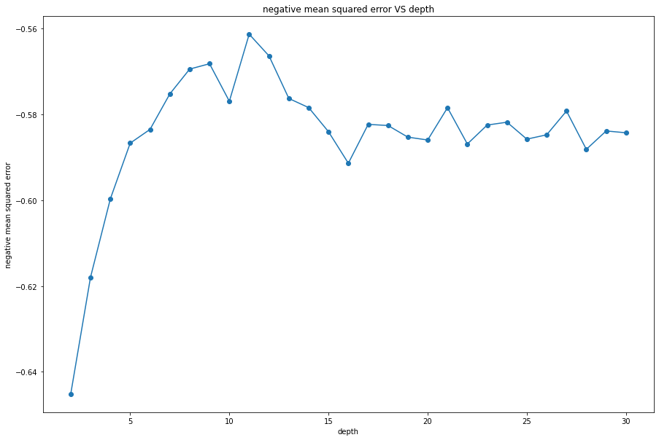
Hyperparameter tuning

Slide 13
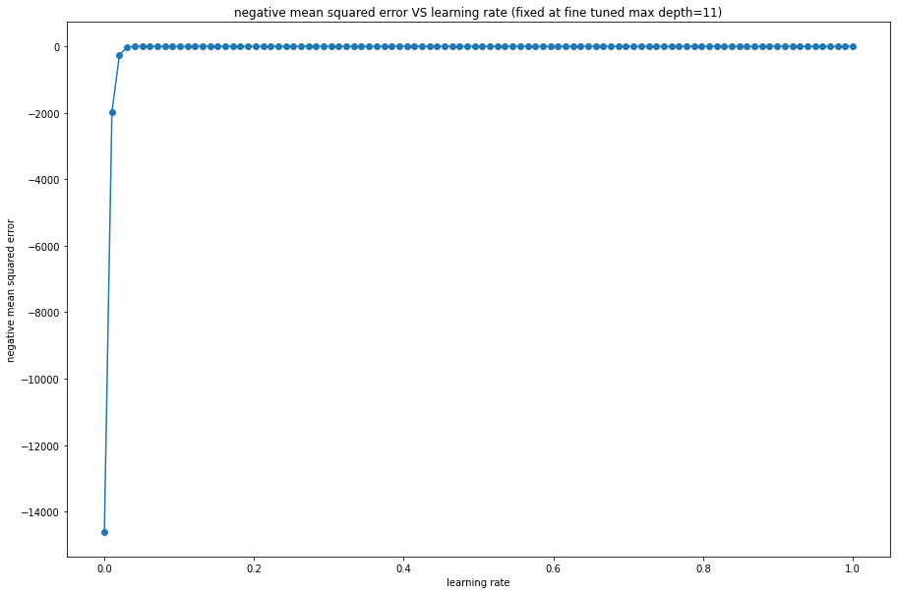
Hyperparameter tuning

Slide 14
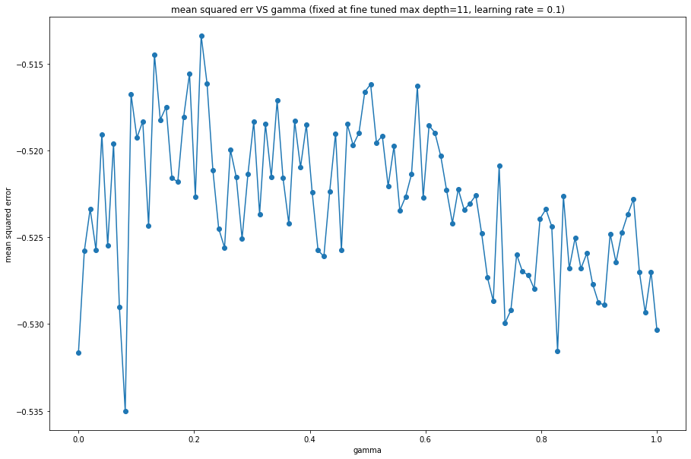
Hyperparameter tuning

Slide 15
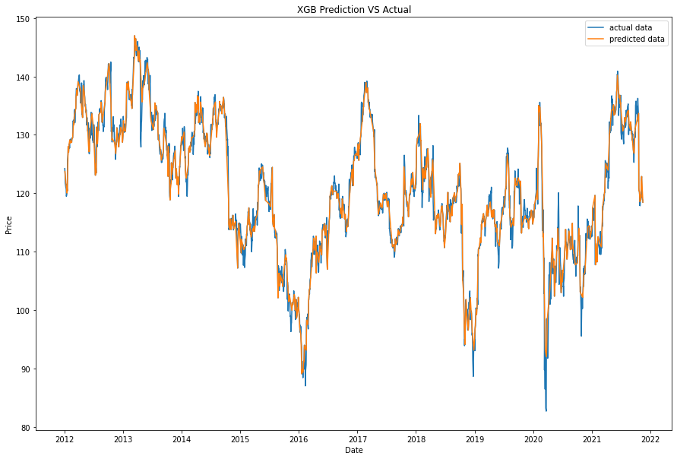
Prediction

Slide 16
Comparative Analysis of Models
Notes:
CREATE A TABLE with RMSE values

Slide 17
Conclusion & Future Work

